Slide 1

EdrenaLine

Slide 2
Agenda
01
02
03
04
To learn and understand the working of an Arduino and how to interface it with our components.
To learn about L298N – this magic driver we are going to use to control our motors & how to interface it.
To learn what motors we are going to use, how do they work, and some alternatives to these motors.
To learn about HC-05, the Bluetooth based controller we will be using and power sources for our car.

Slide 3
Agenda
01
02
03
04
To learn and understand the working of an Arduino and how to interface it with our components.
To learn about L298N – this magic driver we are going to use to control our motors & how to interface it.
To learn what motors we are going to use, how do they work, and some alternatives to these motors.
To learn about HC-05, the Bluetooth based controller we will be using and power sources for our car.

Slide 4
Agenda
01
02
03
04
To learn and understand the working of an Arduino and how to interface it with our components.
To learn about L298N – this magic driver we are going to use to control our motors & how to interface it.
To learn what motors we are going to use, how do they work, and some alternatives to these motors.
To learn about HC-05, the Bluetooth based controller we will be using and power sources for our car.

Slide 5
Agenda
01
02
03
04
To learn and understand the working of an Arduino and how to interface it with our components.
To learn about L298N – this magic driver we are going to use to control our motors & how to interface it.
To learn what motors we are going to use, how do they work, and some alternatives to these motors.
To learn about HC-05, the Bluetooth based controller we will be using and power sources for our car.

Slide 6
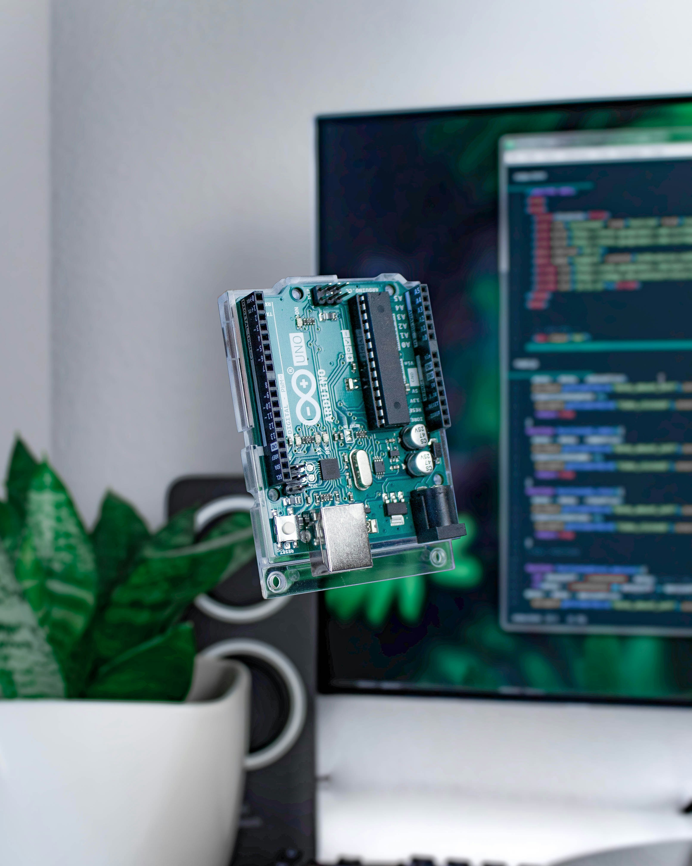
This is an Arduino! An Arduino is an open-source micro-controller based on the Microchip ATmega328P microcontroller (MCU) and developed by Arduino.cc and initially released in 2010.
The microcontroller board is equipped with sets of digital and analog input/output(I/O) pins that may be interfaced to various expansion boards (shields) and other circuits. The board has 14 digital I/O pins (six capable of PWM output), 6 analog I/O pins, and is programmable with the Arduino IDE (Integrated Development Environment), via a type B USB Cable.
One of the best things about Arduino is that the community around is vibrant and supportive, with forums, online tutorials, and documentation readily available. This ecosystem fosters collaboration, knowledge sharing, and the development of innovative projects.

Slide 7
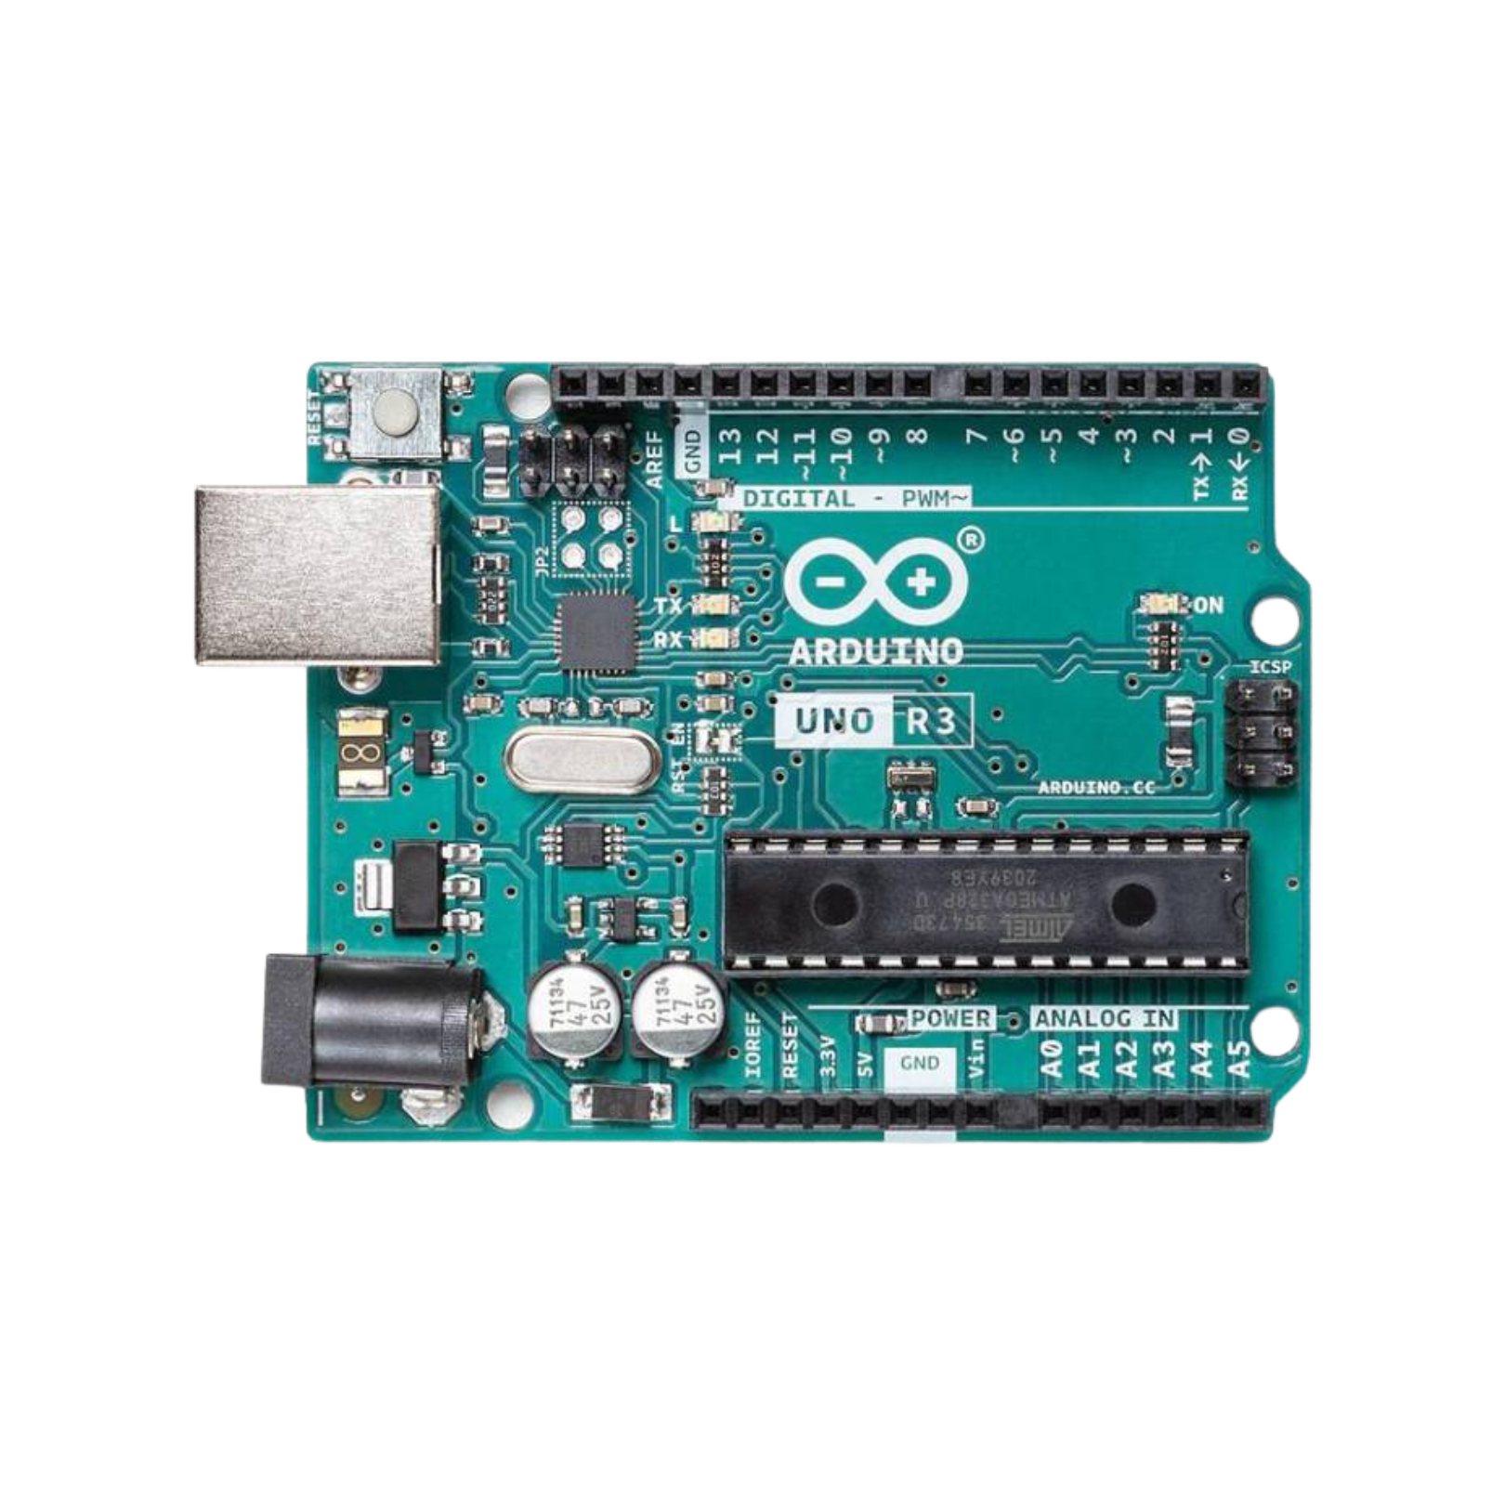
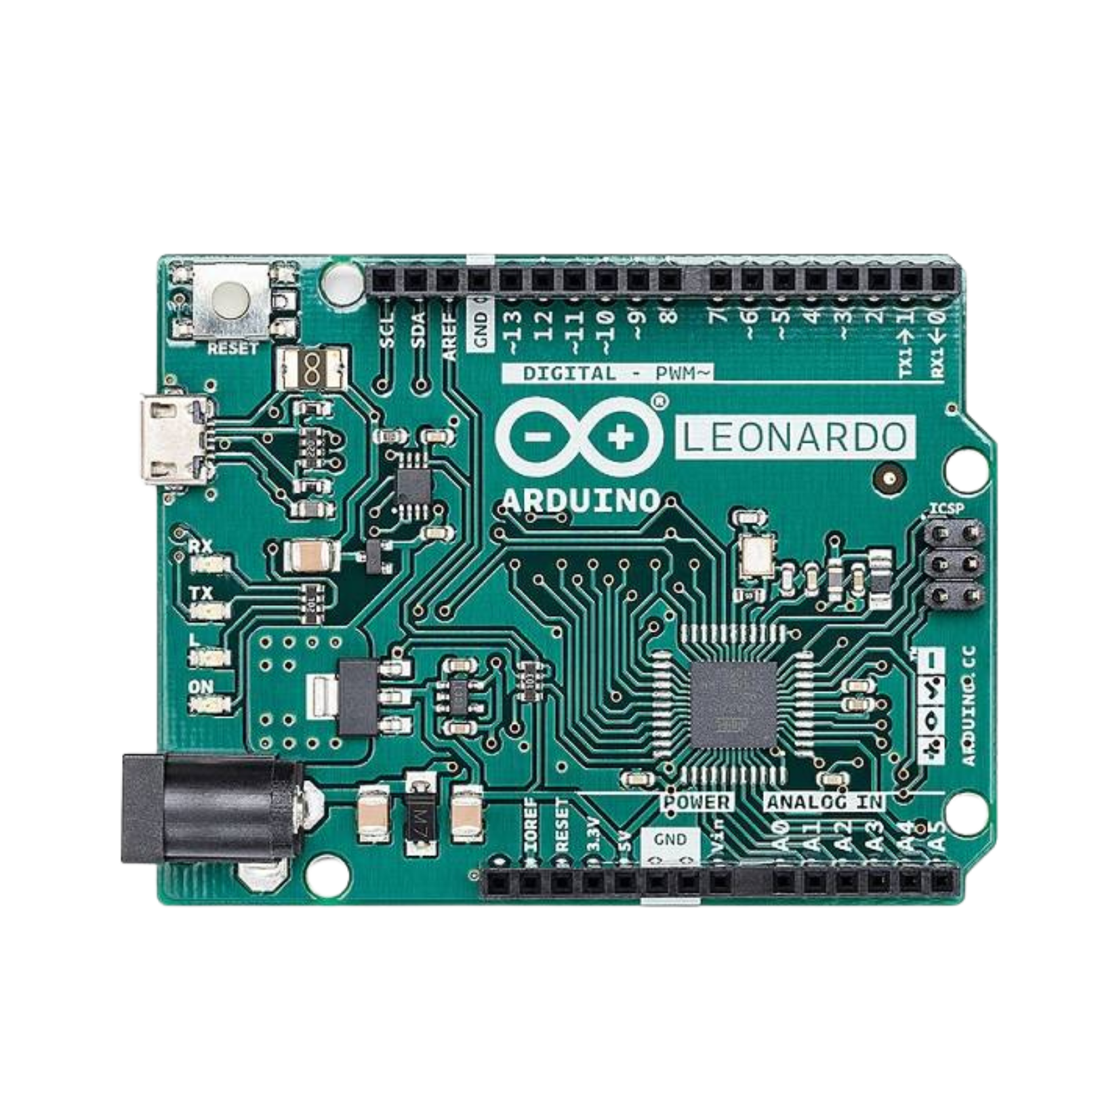
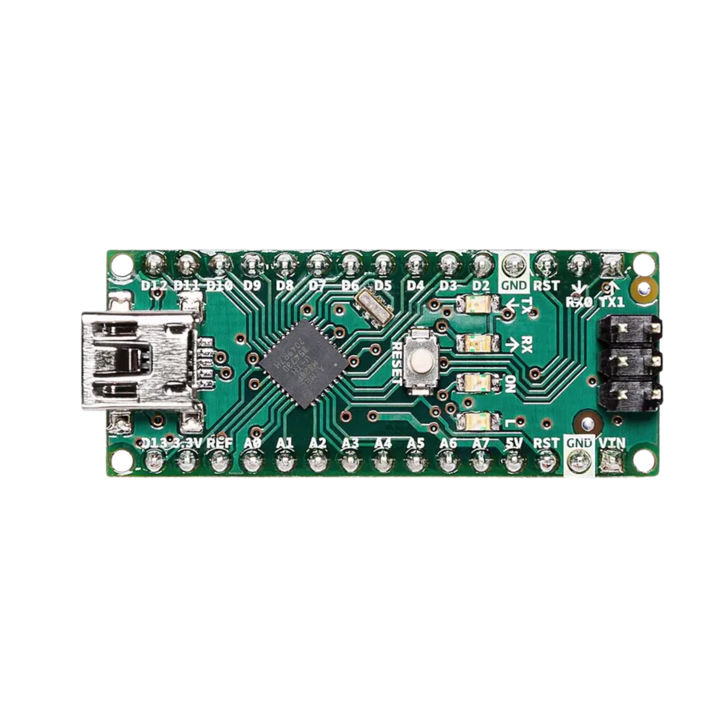
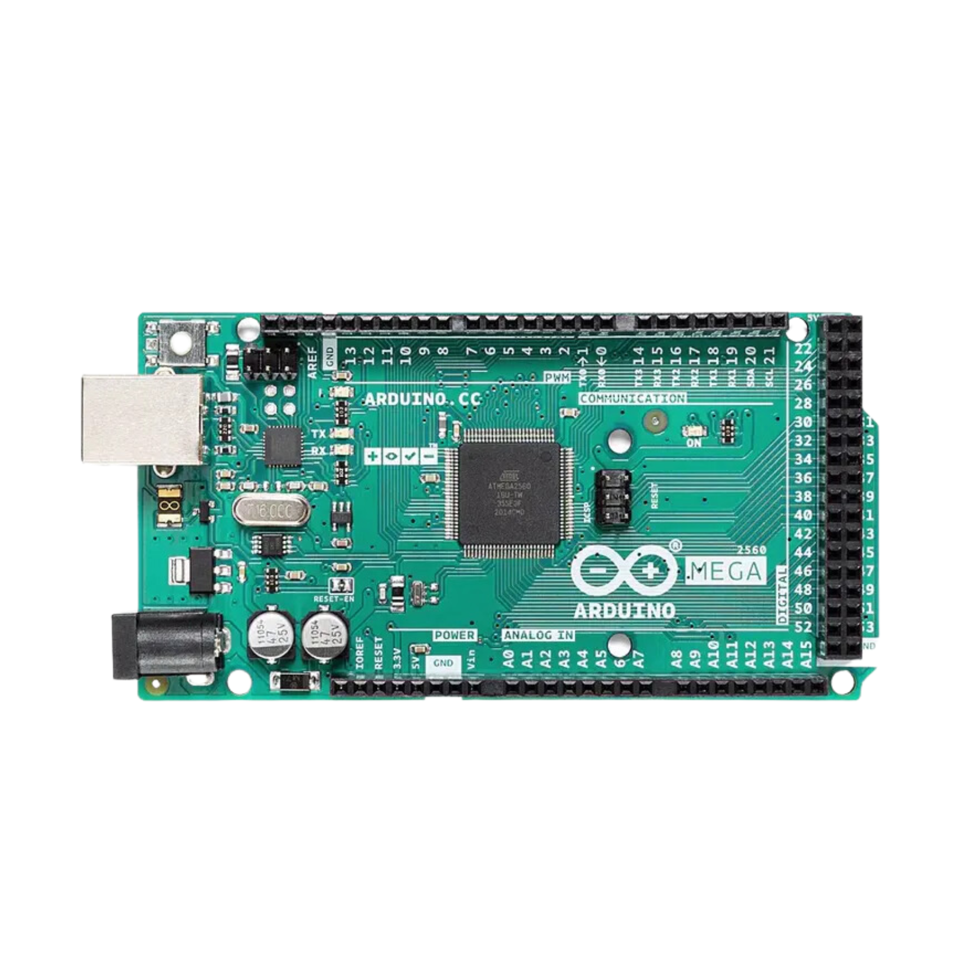
Different Types of Arduino Boards

Slide 8
Arduino Uno
The Arduino Uno is the most popular Arduino board and is widely used for prototyping and DIY projects. It is based on the ATmega328P microcontroller and has 14 digital input/output pins, 6 analog inputs, a 16 MHz ceramic resonator, basic communication ports like SPI, I2C, and UART, USB connection, reset button and a power jack. It has a variety of pre-made modules which makes it easier for developing new electronics projects or prototypes. The Uno is compatible with a wide range of sensors and shields, making it a versatile board for various applications.

Slide 9
Different Types of Arduino Boards

Slide 10
Arduino Leonardo
The Arduino Leonardo is an open-source microcontroller board based on the ATmega32U4 microcontroller. It has 20 digital input/output pins, 7 of which can be used as PWM outputs and 12 as analog inputs. It also has a 16 MHz crystal oscillator, a micro USB connector, an ICSP header, and a reset button.
The unique feature of the Leonardo is its ability to emulate a USB keyboard or mouse. This allows it to be used in projects where a user input device is required, such as a game controller or a keyboard shortcut controller. Additionally, it has native USB communication, so it can act as a USB serial device or a USB MIDI device without the need for additional drivers.
The Leonardo is compatible with the Arduino software and can be programmed using the Arduino IDE. It also supports a range of programming languages including C, C++, and Python.

Slide 11
Different Types of Arduino Boards

Slide 12
Arduino Nano
The Arduino Nano is based on the ATmega328P microcontroller and has similar features to the Uno but small in size compared to the UNO board. It is a small, complete, and breadboard-friendly board. This board includes analog pins-8, digital pins-14 with the set of an I/O pin, power pins-6 & RST (reset) pins-2. It lacks only a DC power jack, and works with a Mini-B USB cable instead of a standard one.

Slide 13
Different Types of Arduino Boards

Slide 14
Arduino Mega
The Arduino Mega is a more powerful board than the Uno and Nano and is ideal for projects that require more processing power and memory. It is based on the ATmega2560 which is an 8-bit microcontroller and has 54 digital input/output pins(of which 15 can be used as PWM outputs), 16 analog inputs, 4 UARTs (hardware serial ports), a 16 MHz crystal oscillator, a USB connection, an ICSP header, a reset button and a power jack.

Slide 15
Different Types of Arduino Boards

Slide 16
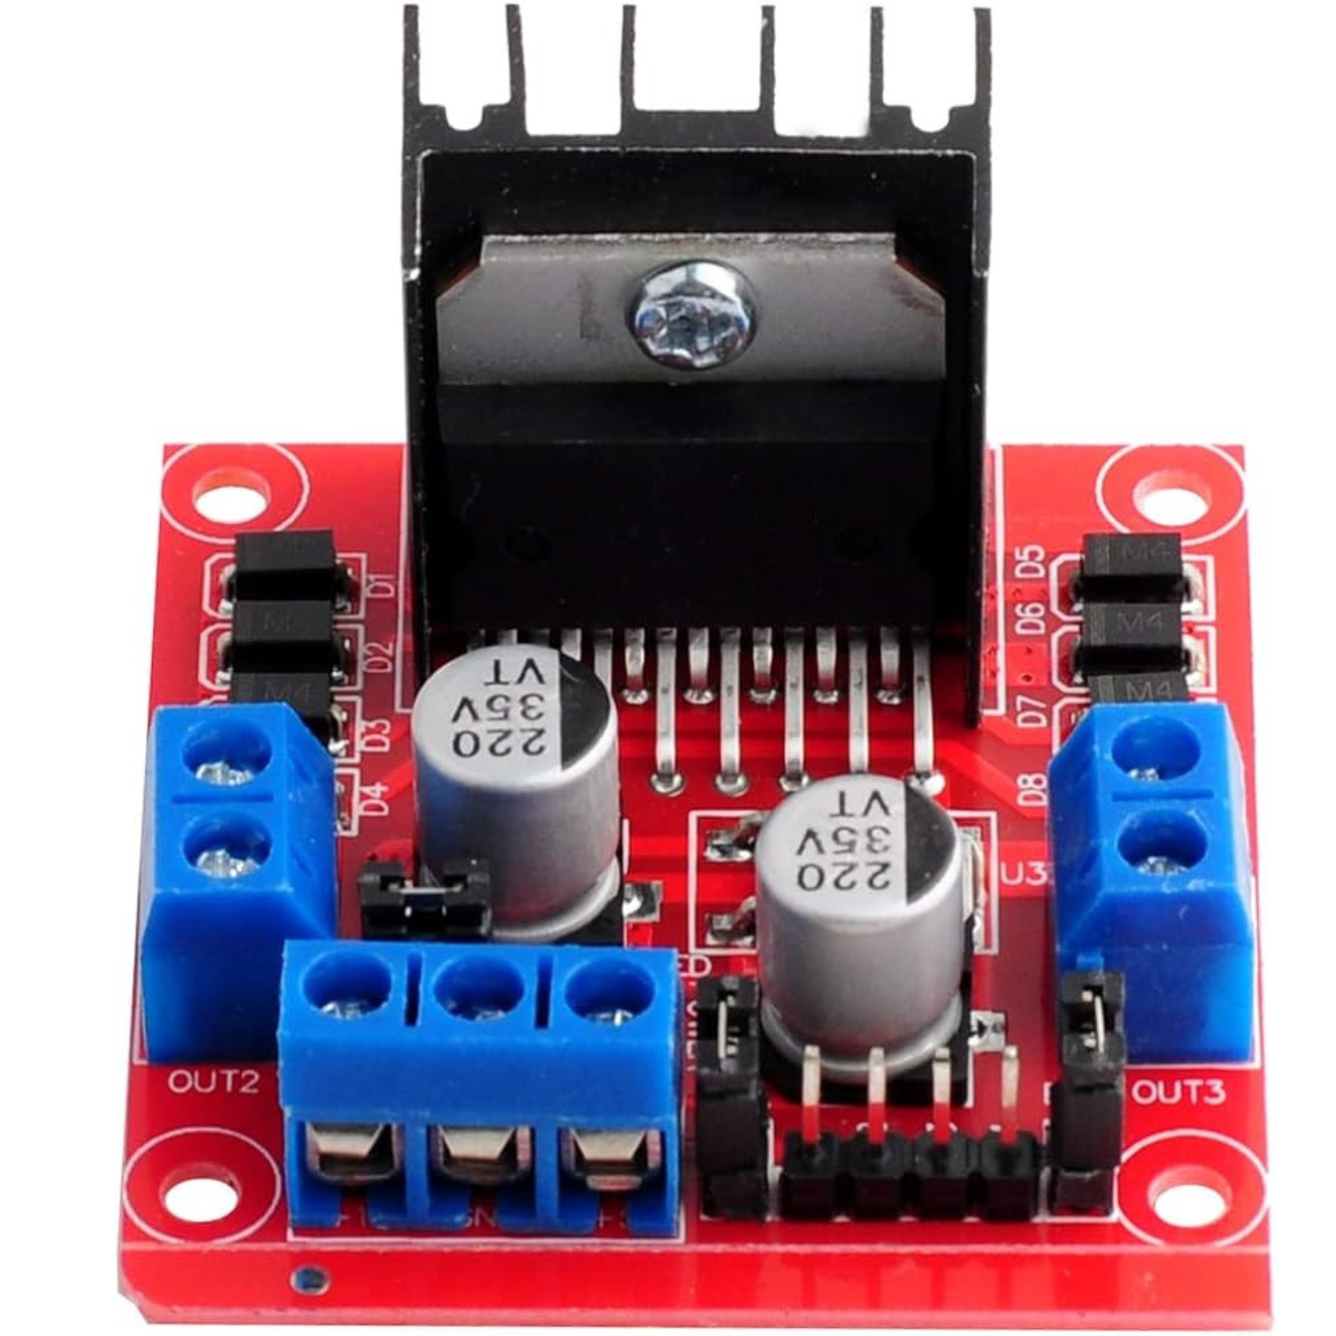
This L298N Motor Driver Module is a high power motor driver module for driving DC and Stepper Motors. This module consists of an L298 motor driver IC and a 78M05 5V regulator. L298N Module can control up to 4 DC motors, or 2 DC motors with directional and speed control.
One of the prime features of this driver is its ENB and ENA pins. Pulling these pins HIGH will cause the motors to spin, while pulling them LOW will stop them. However, with Pulse Width Modulation (PWM), the speed of the motors can be controlled.

Slide 17
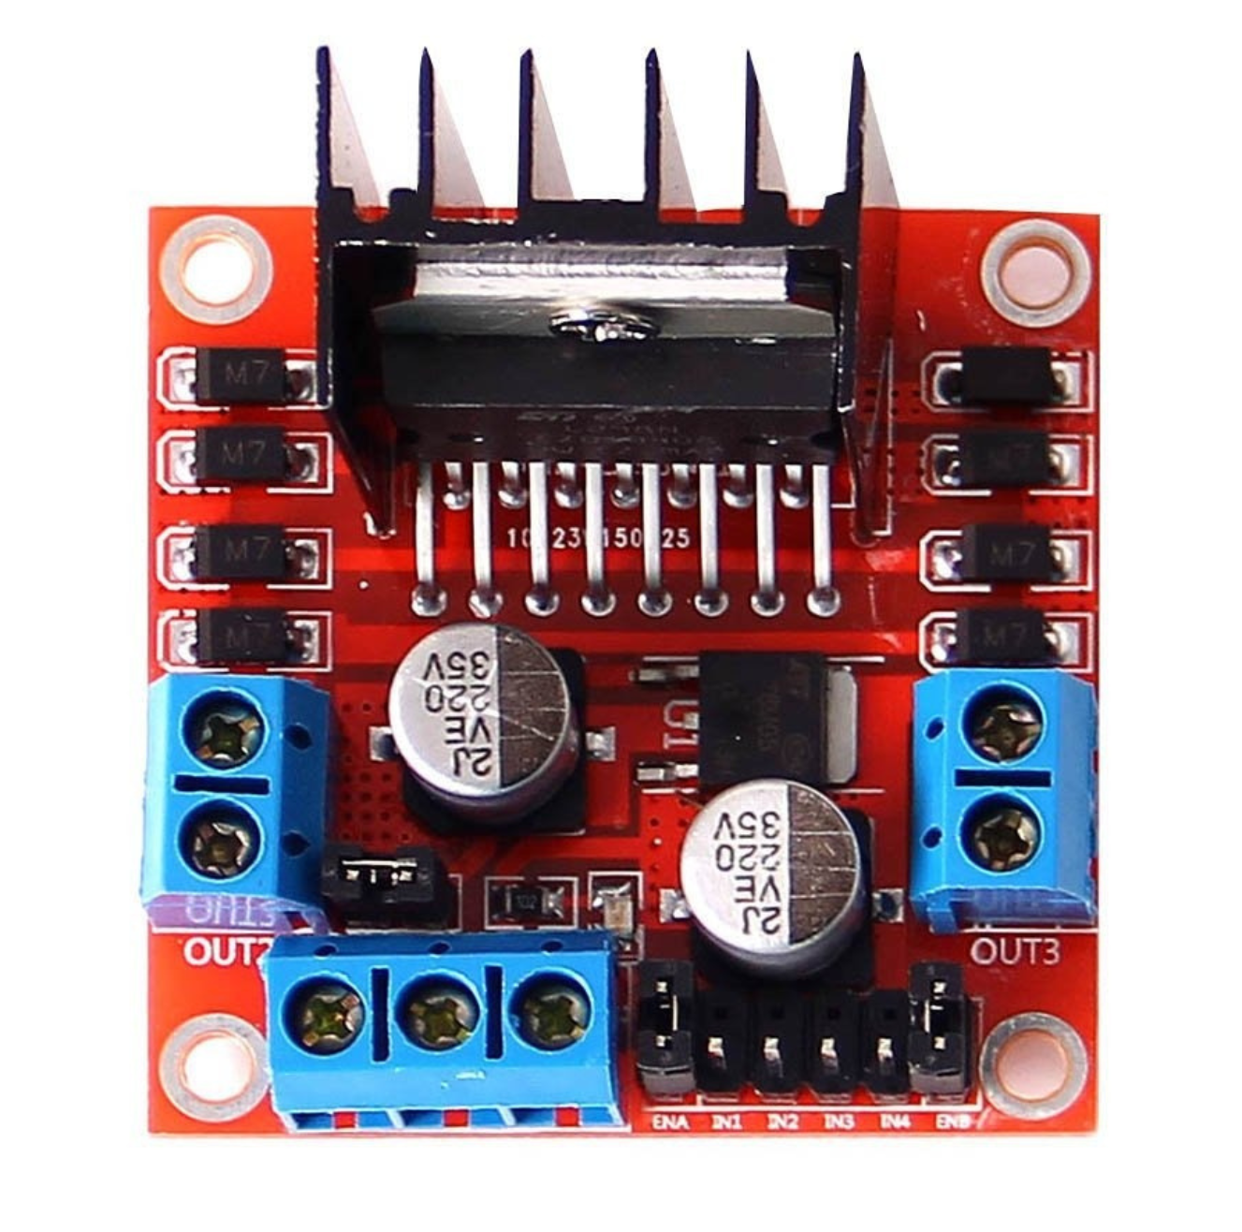
Pins of a L298N
There are two input pins:
VS: VS pin powers the IC’s internal H-Bridge, which drives the motors. This pin accepts input voltages ranging from 5 to 12V.
GND: The common ground pin
VSS: VSS is used to power the logic circuitry within the L298N IC, and can range between 5V and 7V.

Slide 18
Pins of a L298N
There are four output points, OUT1, OUT2, OUT3 and OUT4.
These are what we are going to use to connect our motors. Each of these pins can supply 2A to each motors.

Slide 19
Pins of a L298N
There are two input pins:
VS: VS pin powers the IC’s internal H-Bridge, which drives the motors. This pin accepts input voltages ranging from 5 to 12V.
GND: The common ground pin
VSS: VSS is used to power the logic circuitry within the L298N IC, and can range between 5V and 7V.

Slide 20
Pins of a L298N
The module has two direction control pins. The IN1 and IN2 pins control the spinning direction of motor A.
While IN3 and IN4 control the spinning direction of motor B.
The spinning direction of the motor can be controlled by applying logic HIGH (5V) or logic LOW (Ground) to these inputs.

Slide 21
Pins of a L298N
As discussed before, there are two speed control pins, that is the ENB and ENA pins.
Pulling these pins HIGH will cause the motors to spin, while pulling them LOW will stop them. However, with Pulse Width Modulation (PWM), the speed of the motors can be controlled.

Slide 22
Pins of a L298N
As discussed before, there are two speed control pins, that is the ENB and ENA pins.
Pulling these pins HIGH will cause the motors to spin, while pulling them LOW will stop them. However, with Pulse Width Modulation (PWM), the speed of the motors can be controlled.

Slide 23
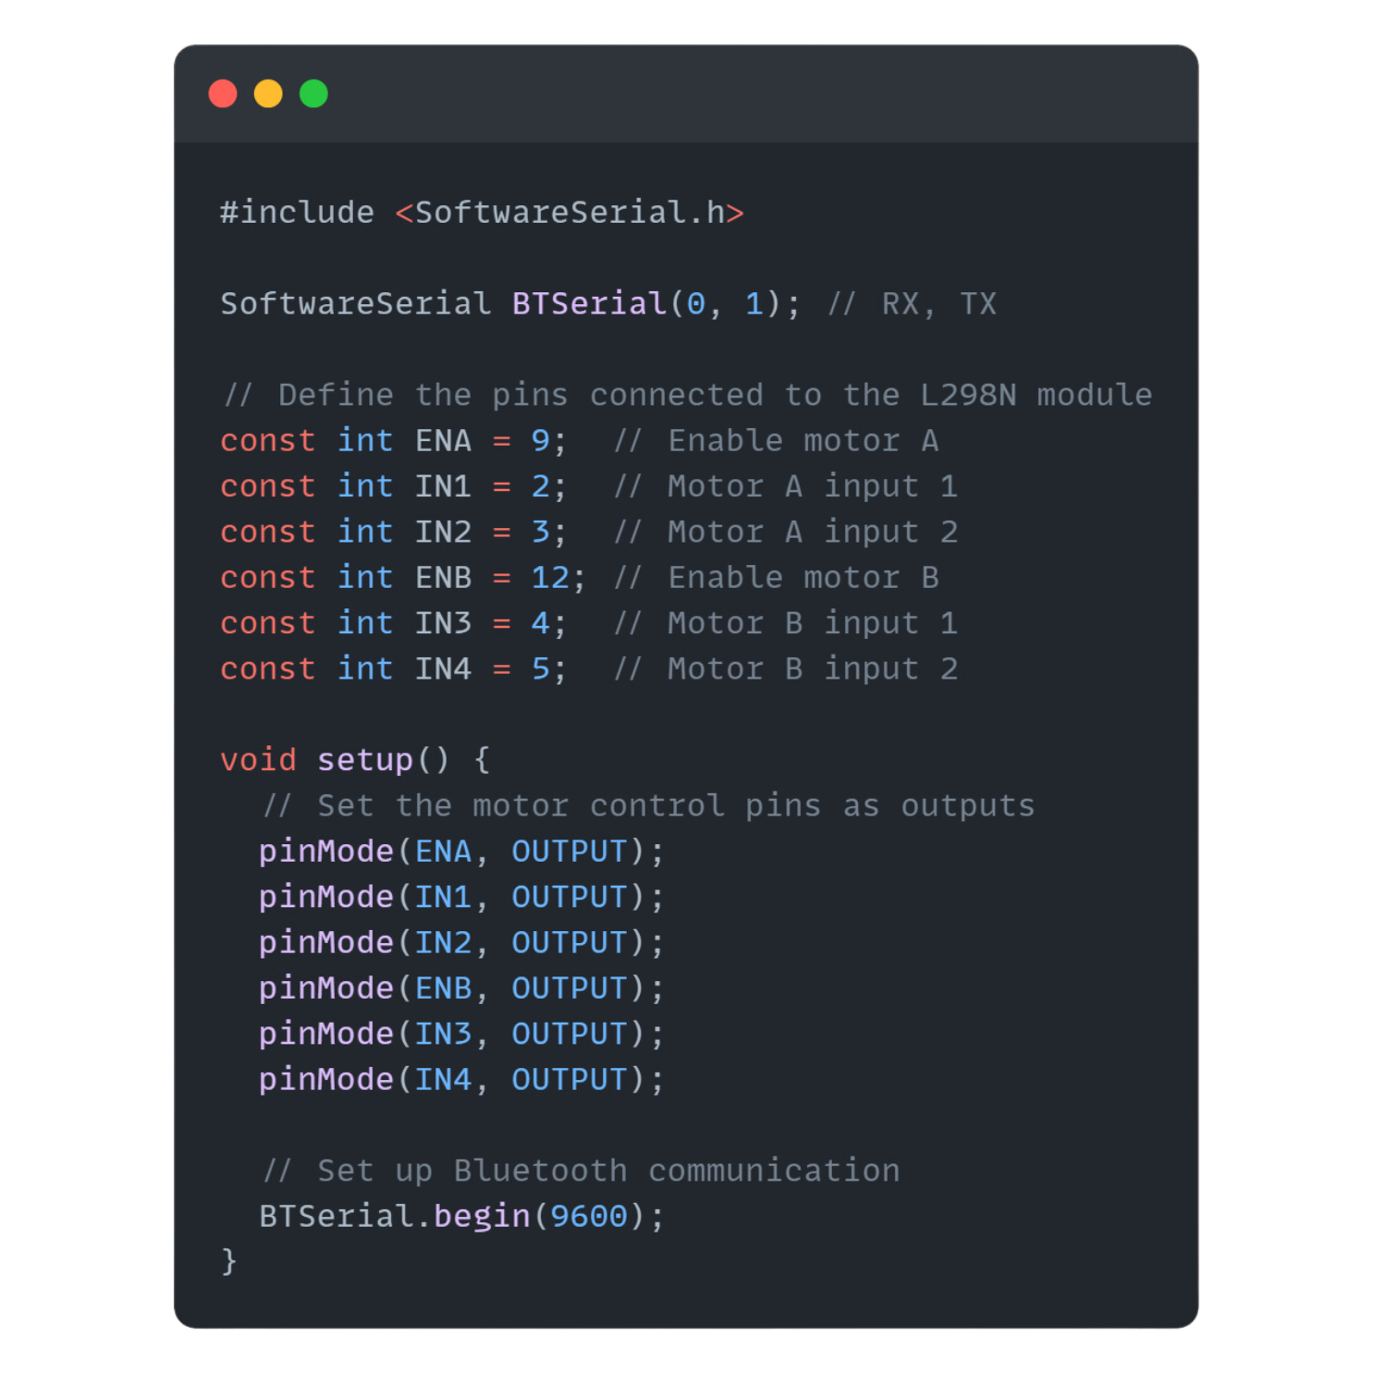
Interfacing an L298N with an Arduino
In order to interface our motors, we should connect the OUT1, OUT2, OUT3 and OUT4 with our motor.
For our input pins, we should interface it with the Digital pins of the Arduino.
Namely,
IN1 → Digital Pin 2
IN2 → Digital Pin 3
IN3 → Digital Pin 4
IN4 → Digital Pin 5

Slide 24
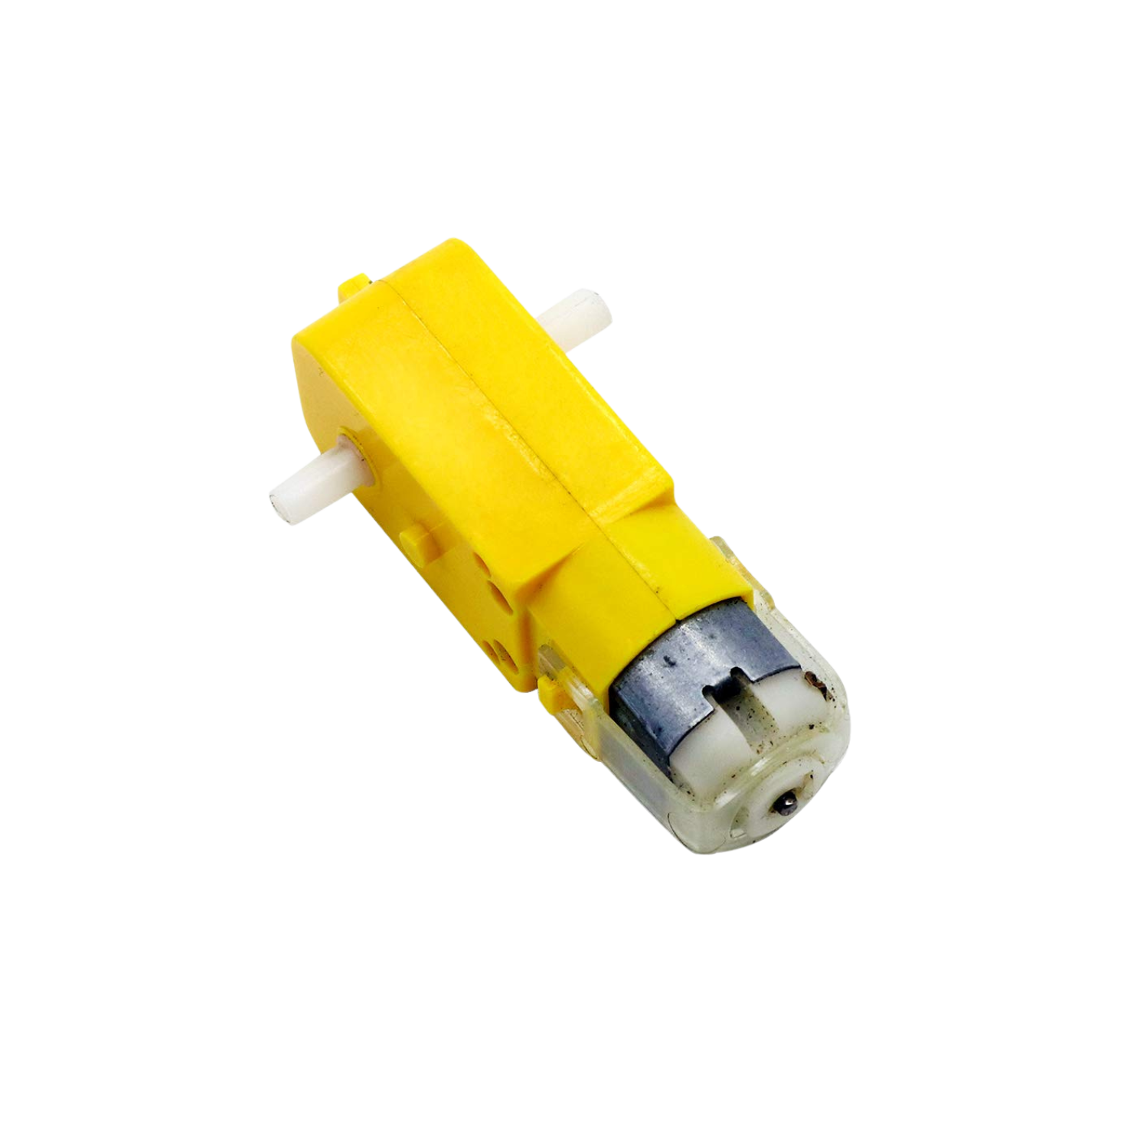
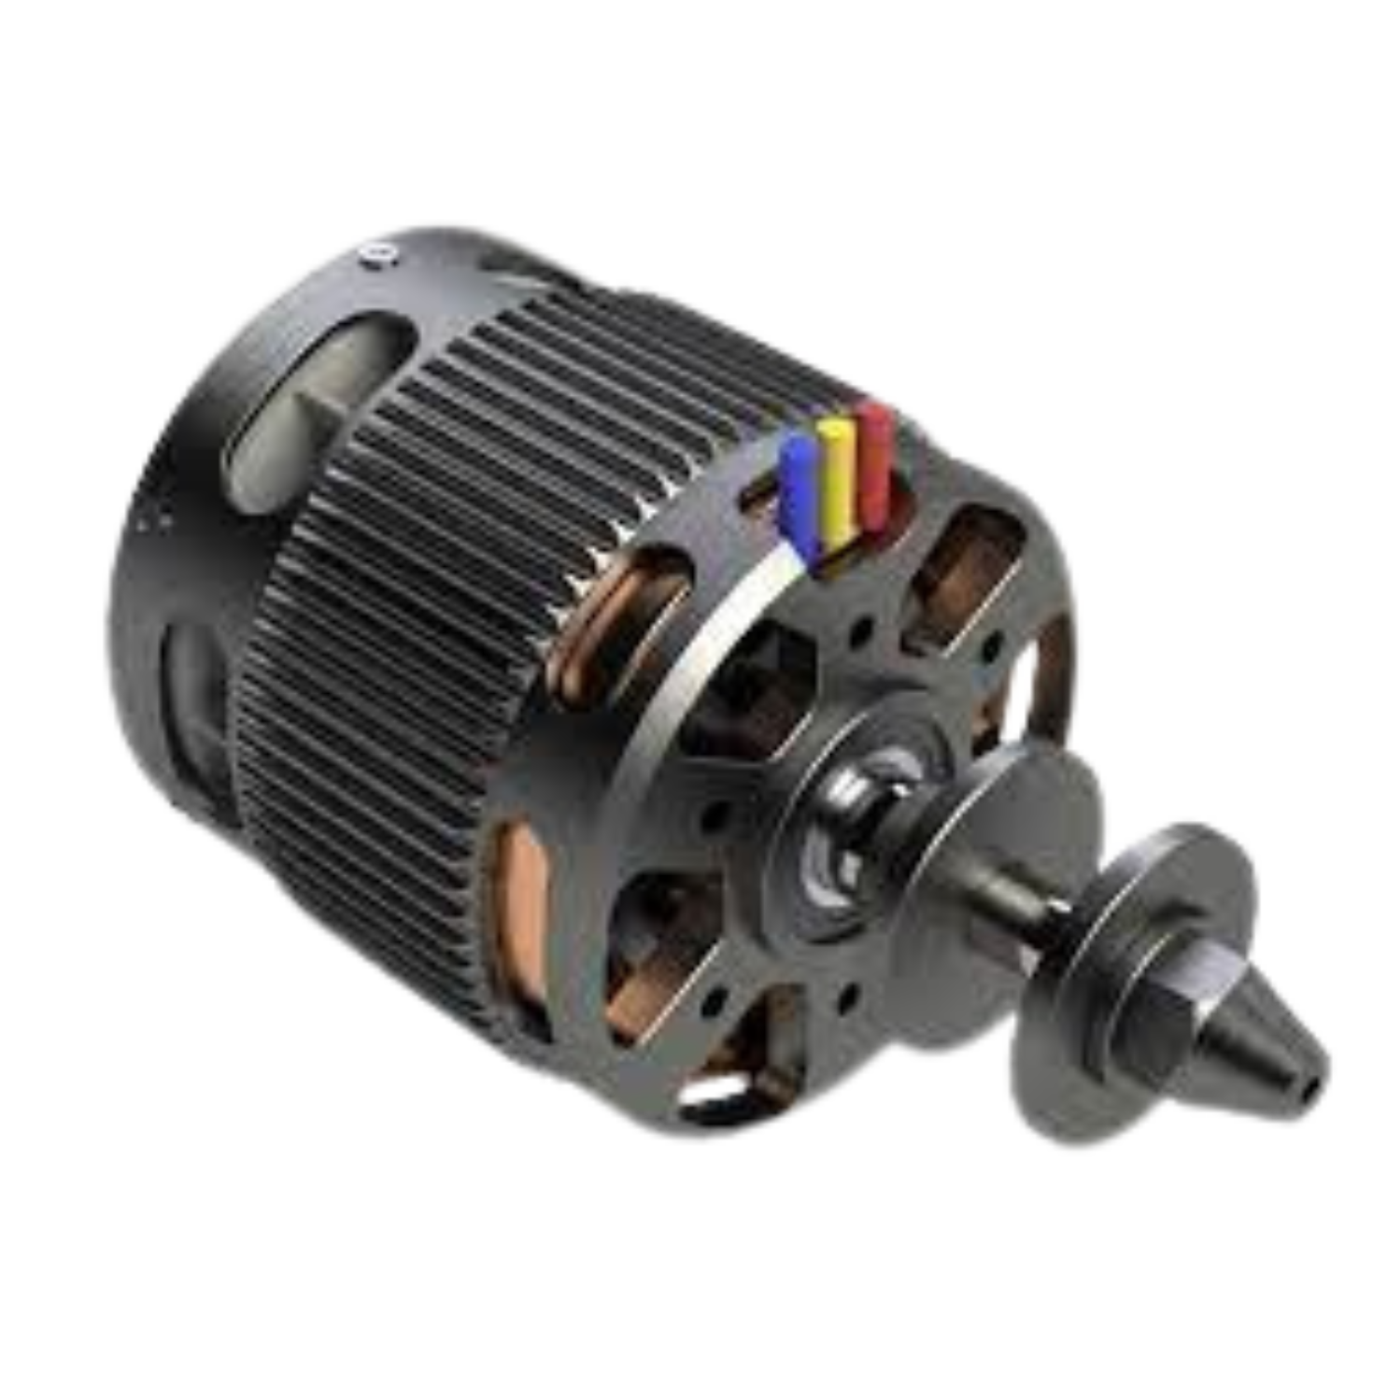
Types of Motors
DC Brushless Motor
DC Motor

Slide 25
DC Motor
DC motor (Direct Current motor) is the most common type of motor. DC motors normally have just two leads, one positive and one negative. If you connect these two leads directly to a battery, the motor will rotate. If you switch the leads, the motor will rotate in the opposite direction. Basically, clockwise and anti-clockwise.

Slide 26
Types of Motors
DC Brushless Motor
DC Motor

Slide 27
DC Brushless Motor
Brushless DC electric motors also known as electronically commutated motors (ECMs, EC motors).
As their name implies, brushless DC motors do not use brushes. With brushed motors, the brushes deliver current through the commutator into the coils on the rotor.

Slide 28
Types of Motors
DC Brushless Motor
DC Motor

Slide 29
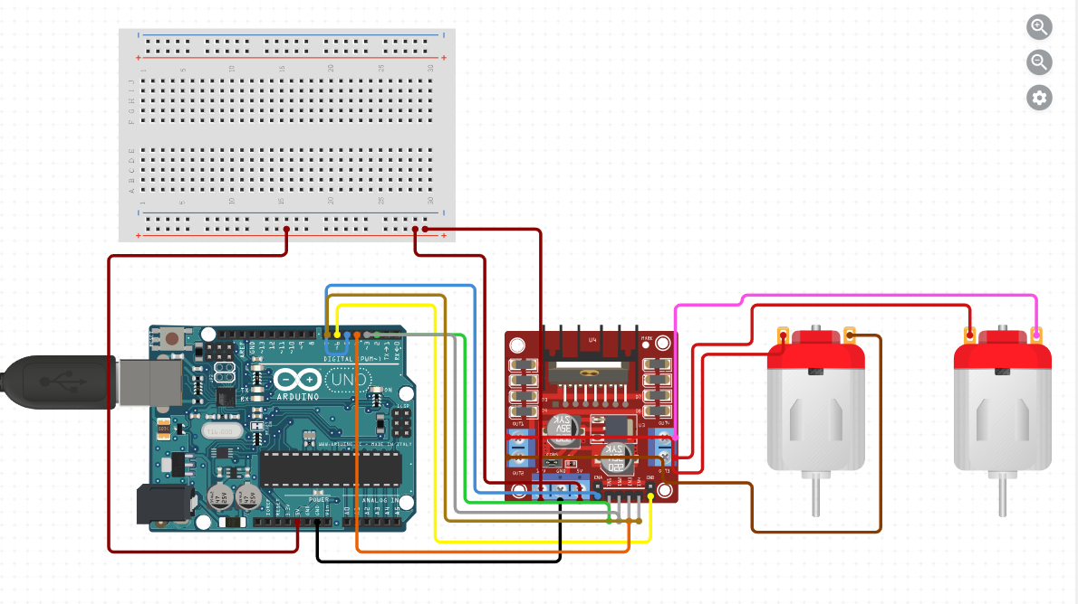
Interfacing a DC Motor with L298D

Slide 30
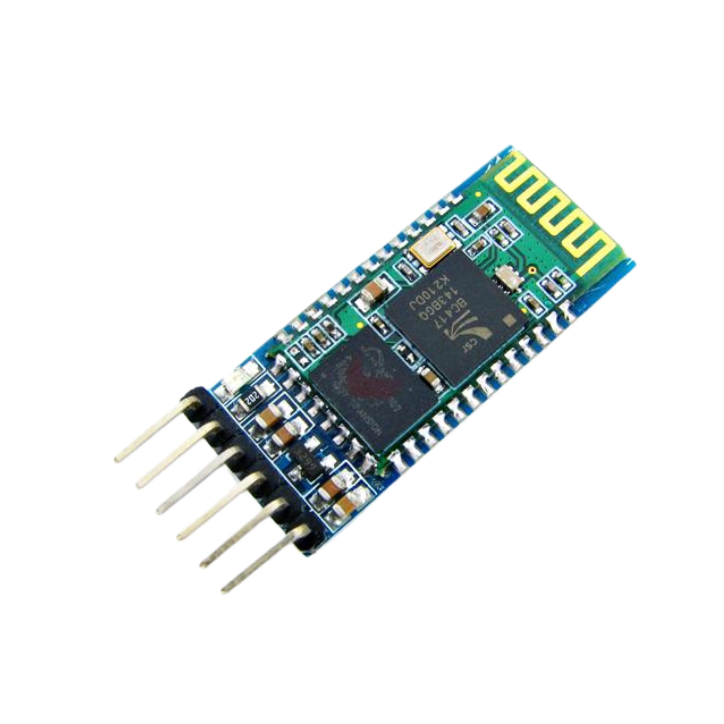
The HC-05 is a Bluetooth module
that can be used as a UART serial converter module to
transfer data wirelessly.
It can be used as a master or slave
device for transmitter and receiver,
and can connect to most phones and computers with Bluetooth.
The HC-05 is designed to replace cable connections and uses serial communication to communicate with the electronics. It has a frequency of 2.4GHz ISM
band, PIO control and
comes with an integrated
antenna and edge connector.

Slide 31
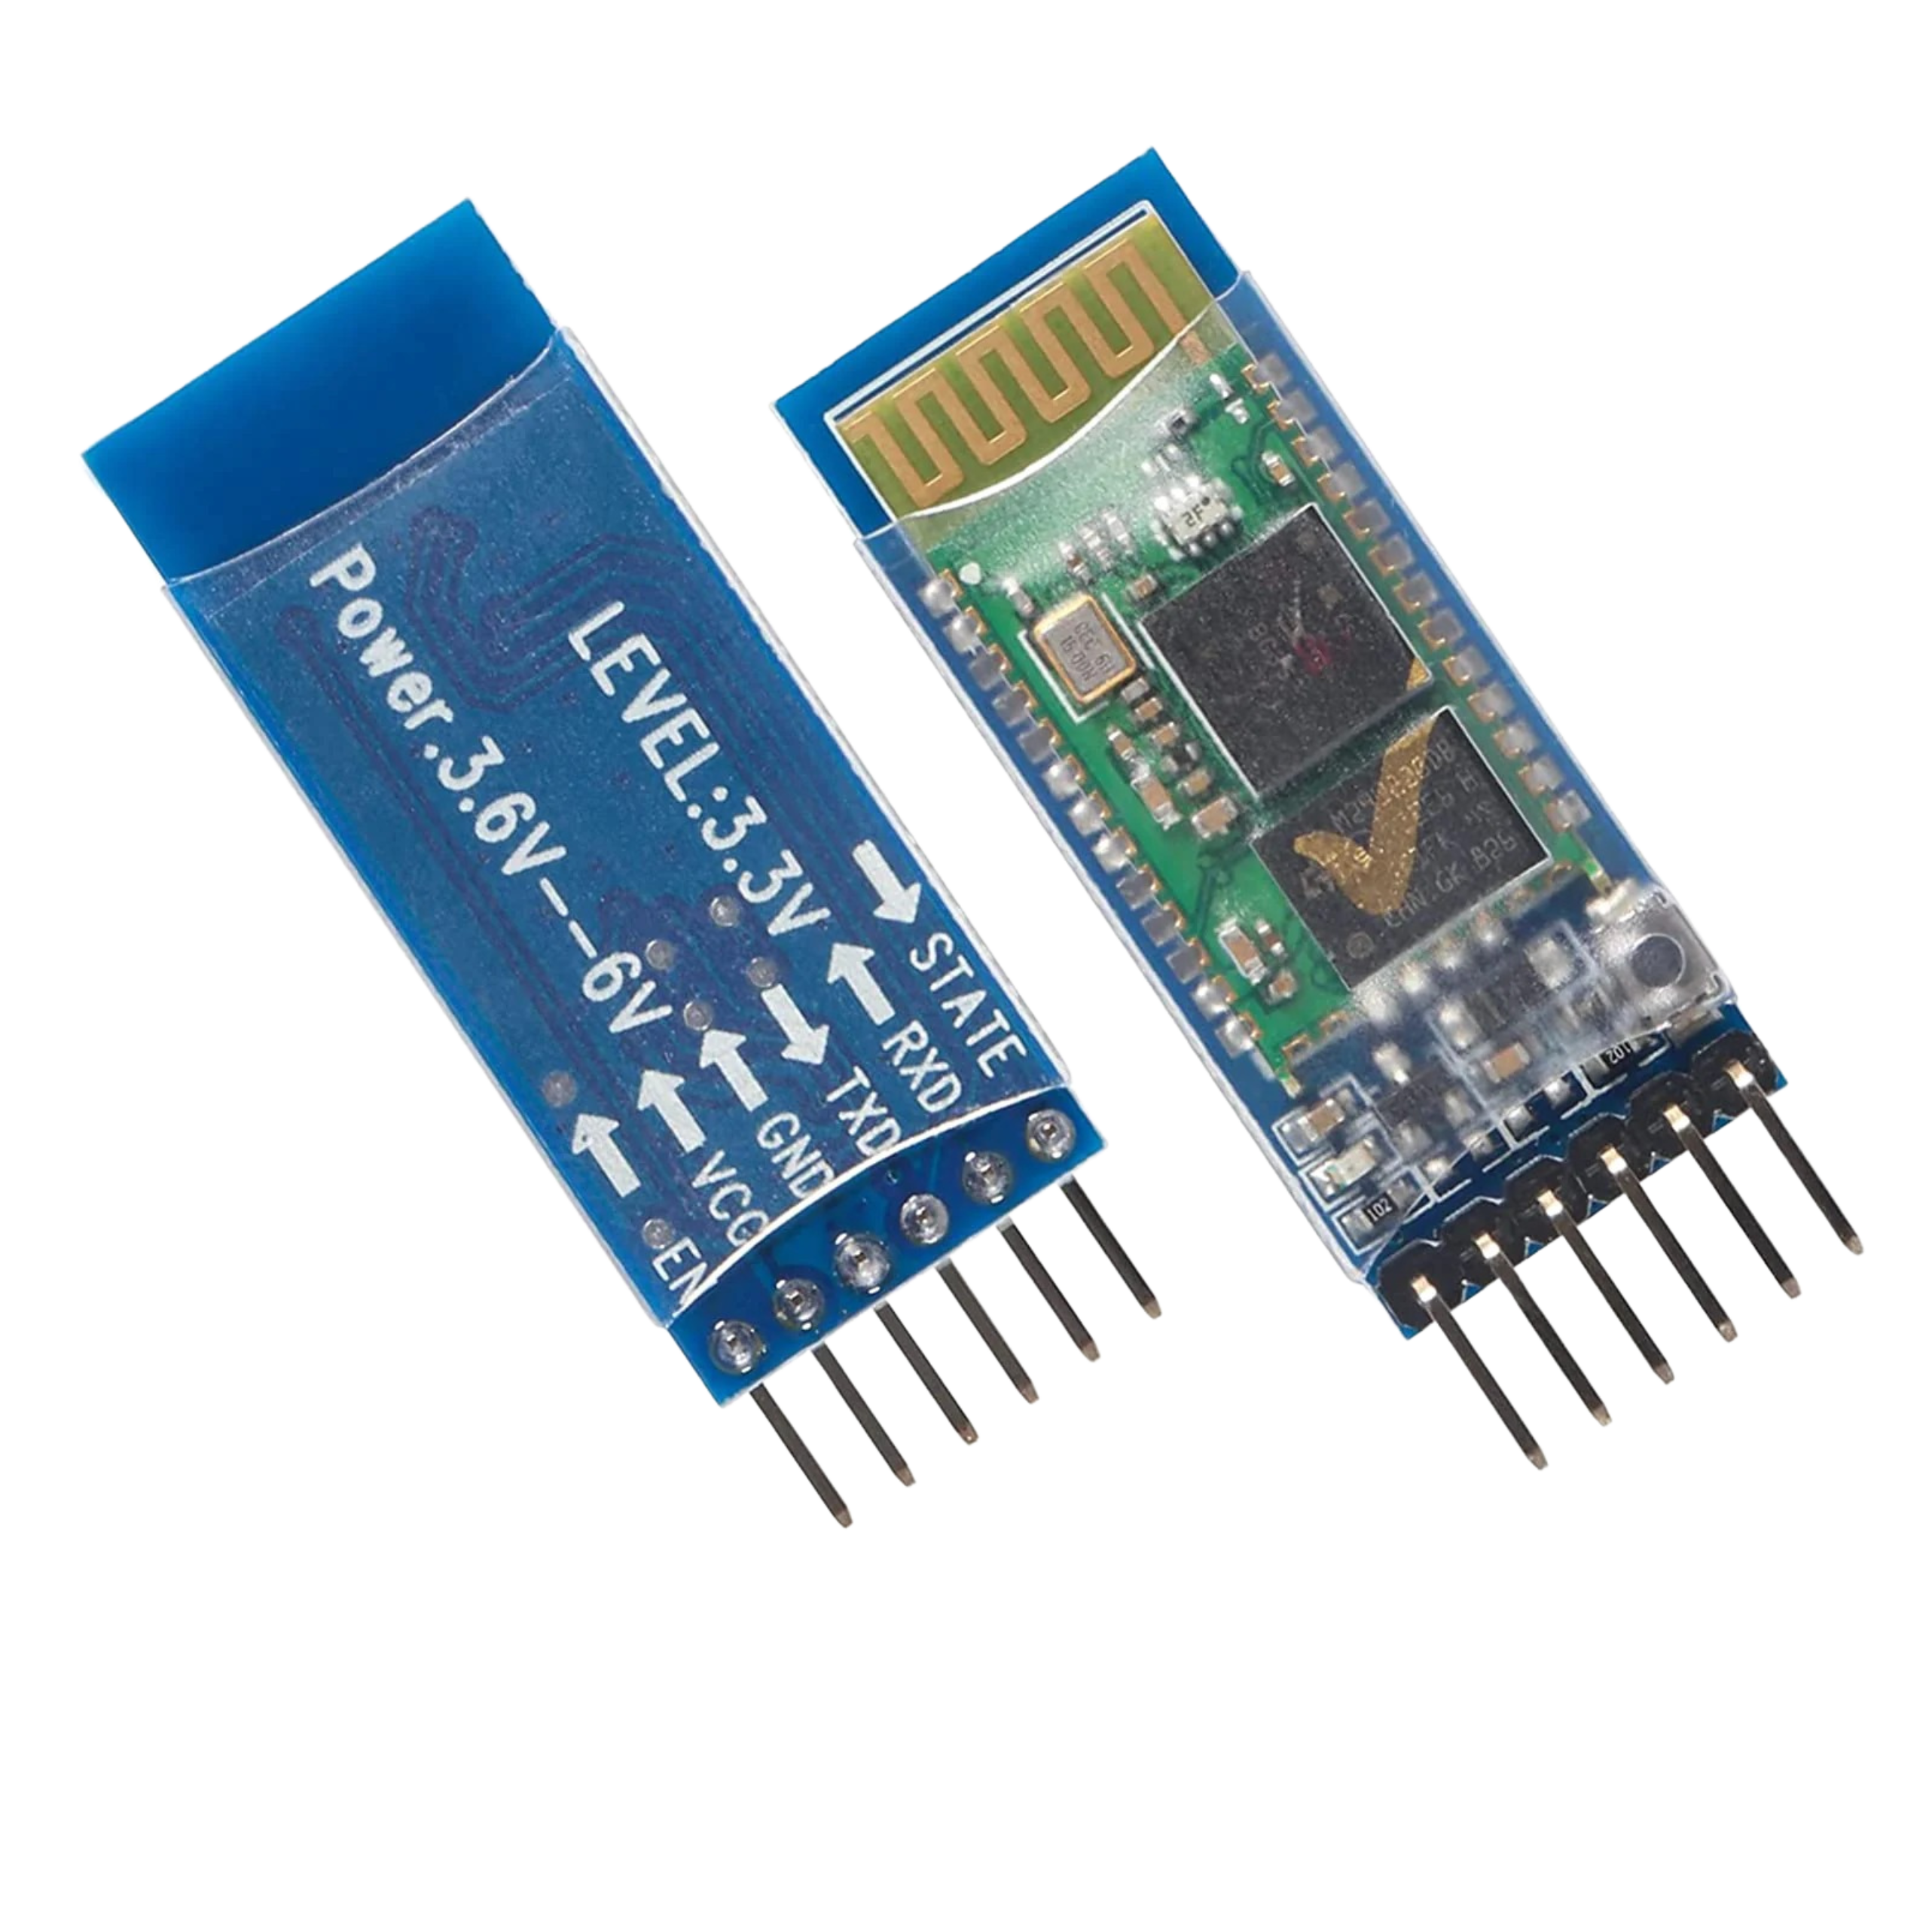
Interfacing the HC-05 Bluetooth Module
In order to interface our HC-05 Bluetooth module, first we have to define the baud rate of the module to it’s specified value, i.e., 9600.
After this, we have to connect each pin of our module to various pins of the Arduino board.
Here is a the arrangement:
GND → Ground pin in the Arduino board
VCC → 5V pin in the Arduino board
RXD → TX Pin in the Arduino Board
TXD →RX pin in the Arduino board

Slide 32
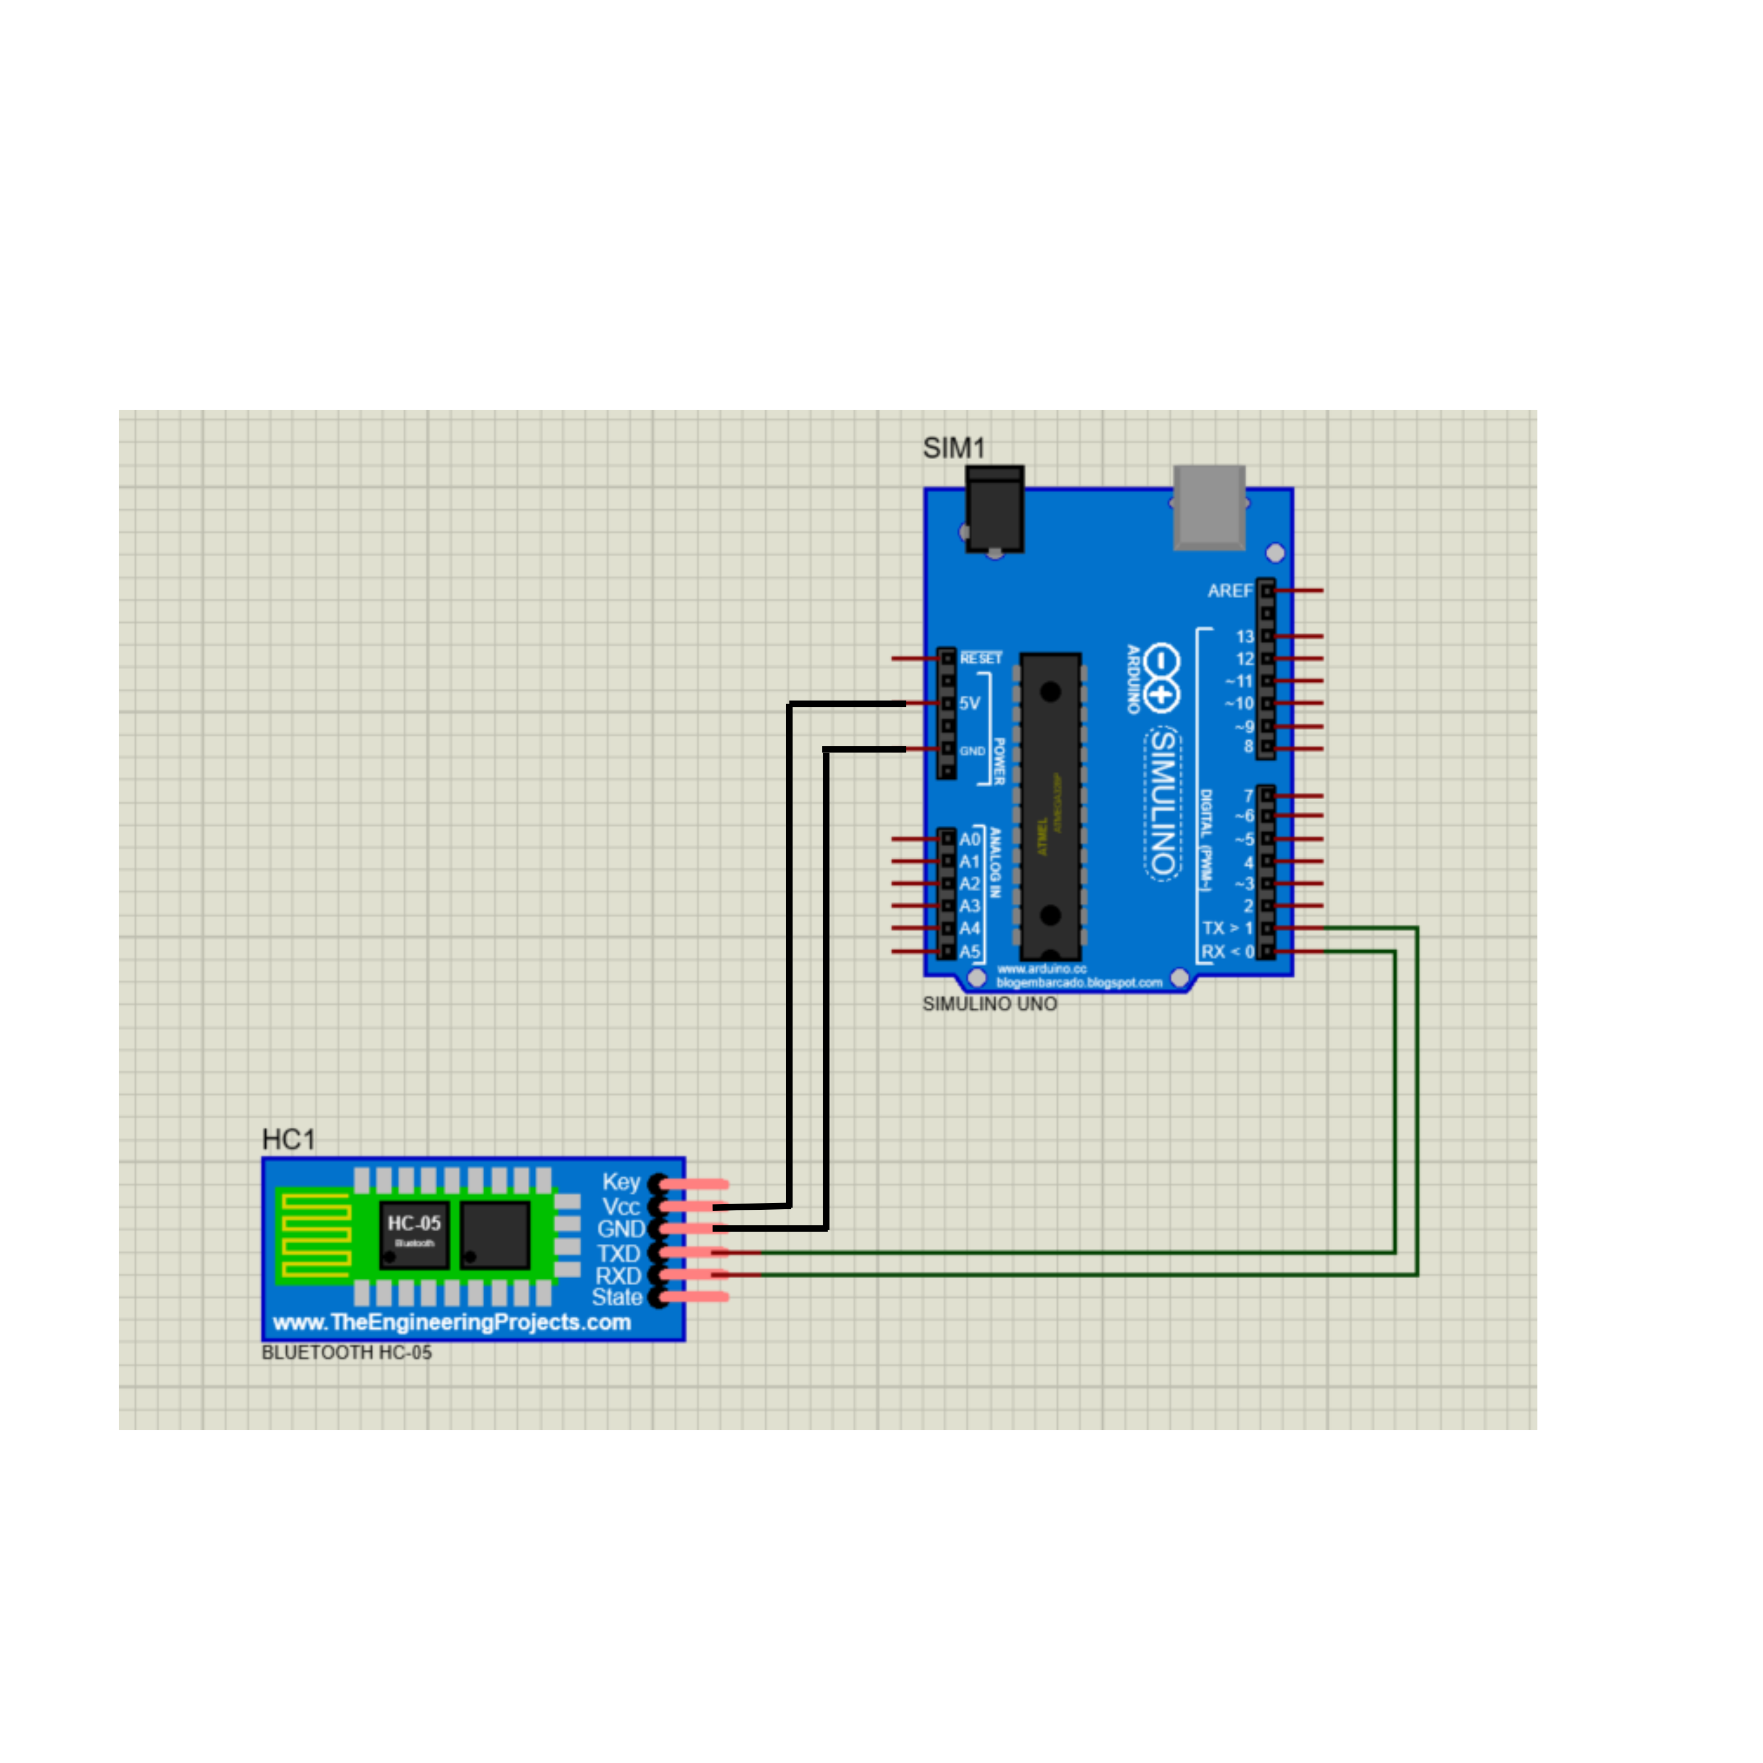
Interfacing the HC-05 Bluetooth Module

Slide 33
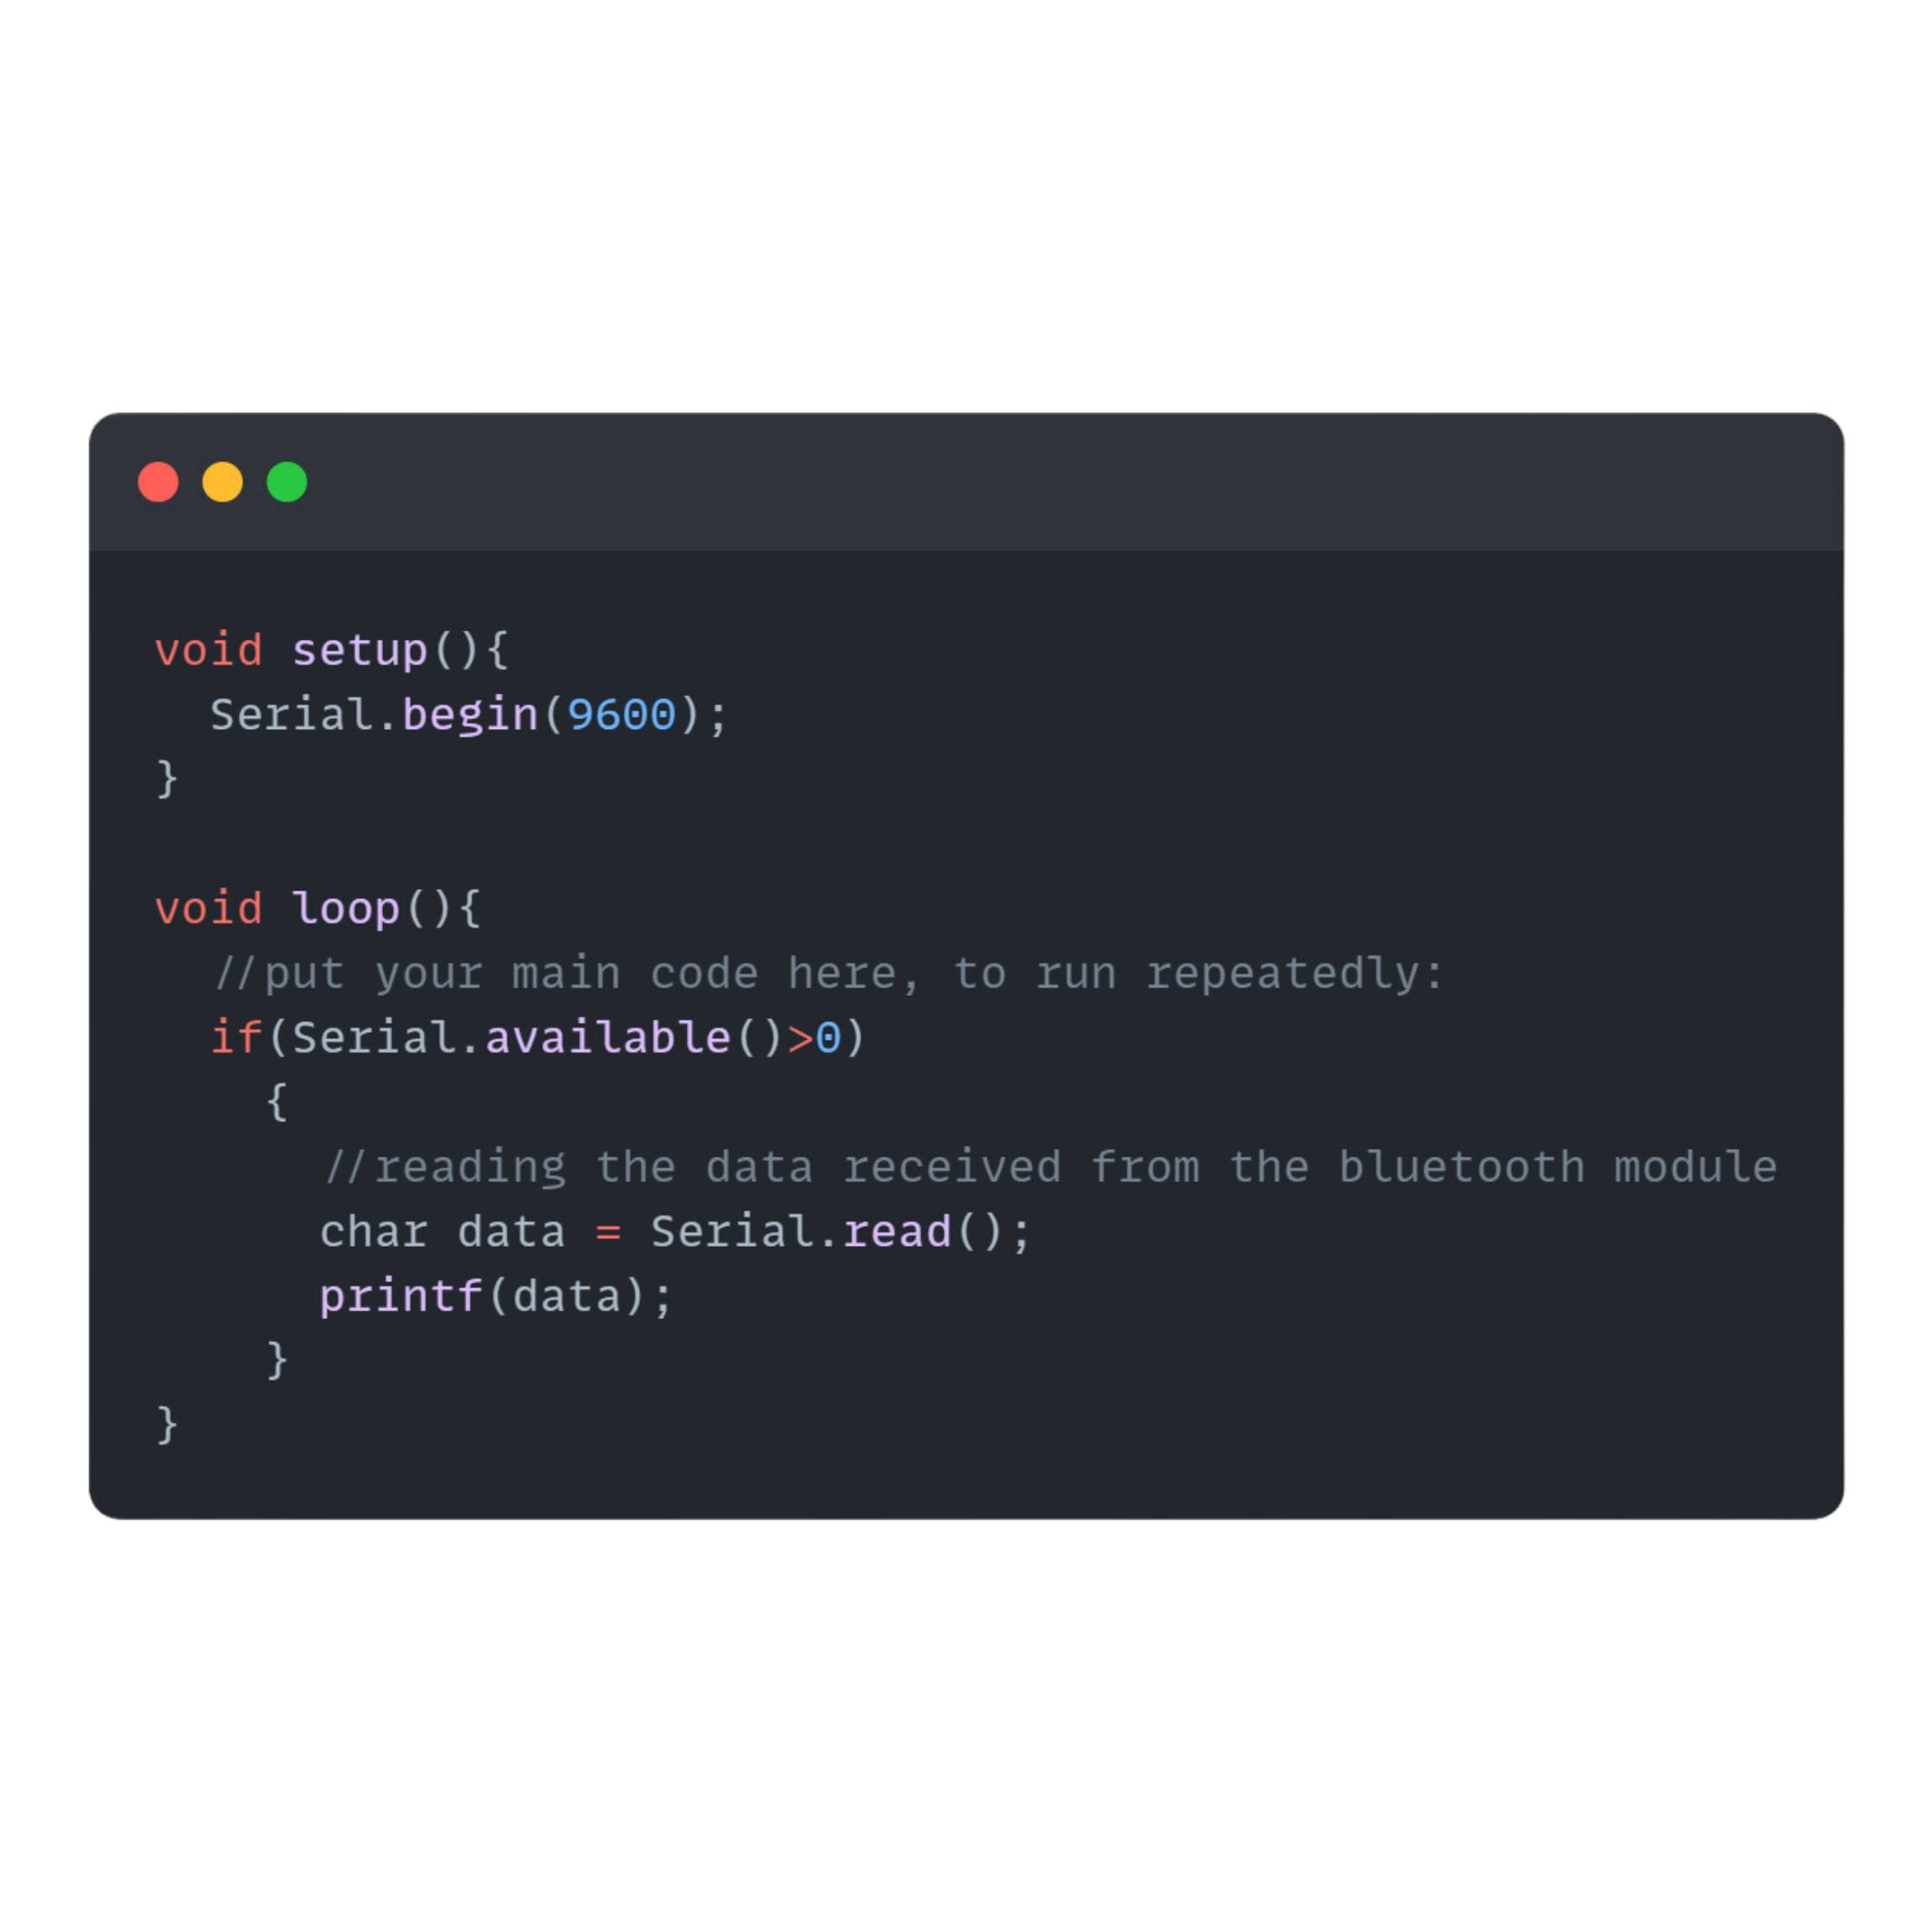
Code

Slide 34
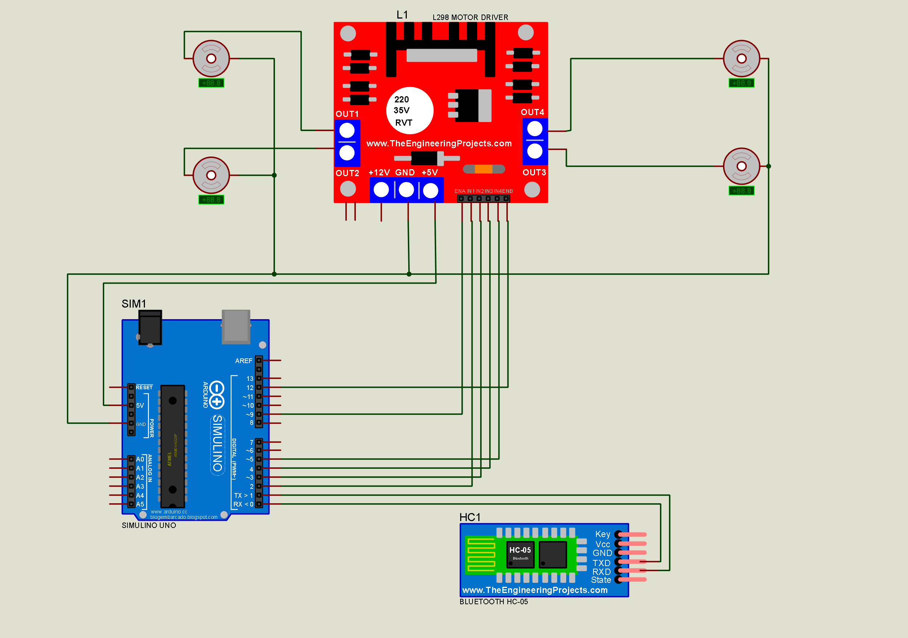
Rounding everything off, we will have,

Slide 35
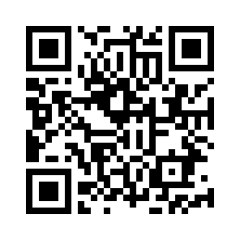
EdrenaLine
TechFiesta 2024
Git Repo
Link: https://github.com/SS56Bo/TechFiesta_EnduraLine

Slide 36
THANK YOU

